Slide 1

Learning intentions
Problem solve using Pythagoras
EQ: How do we problem solve using Pythagoras?

Slide 2
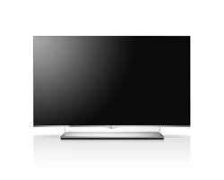
Buying a new TV.

Slide 3

Buying a New TV
What do you look for when buying a new TV?
Make a list
Price
Size
Brand
How good it looks
Image quality
connectivity

Slide 4
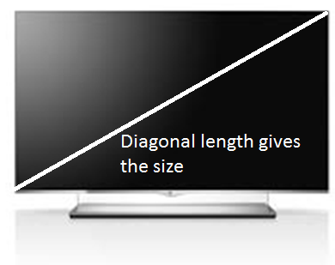
Televisions come in a range of different sizes.
The problem with TV sizes is that they are in inches. We need to convert them to cm.
1 inch = 2.54cm
22” | 26” | 32” | 37” | 42” | 54” | 58” | 65” | 70”
56cm

Slide 5
Televisions come in a range of different sizes.
The problem with TV sizes is that they are in inches. We need to convert them to cm.
1 inch = 2.54cm
22” | 26” | 32” | 37” | 42” | 54” | 58” | 65” | 70”
56cm | 66cm | 81cm | 94cm | 107cm | 137cm | 147cm | 165cm | 178cm

Slide 6
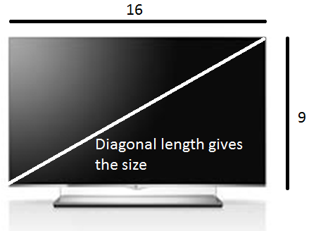
TV lengths and widths are in the ratio of 16:9.
We can make a scale factor by 16÷9= 1.78. This means the length is always 1.78 times bigger than the width.

Slide 7

Information so far
The length is 1.78 times larger than the width
TV sizes
22” | 26” | 32” | 37” | 42” | 54” | 58” | 65” | 70”
56cm | 66cm | 81cm | 94cm | 107cm | 137cm | 147cm | 165cm | 178cm

Slide 8
Tom’s TV
Tom goes to the shop wanting to buy a new TV.
Unfortunately Tom didn’t realise that TV sizes where measured in Diagonals.
He has measured the spot he wants his TV. The space on the wall is 1.4m in length and 1.1m in width. What is the biggest TV he can buy?

Slide 9
Tom’s TV
Step 1:
Do his dimensions fit with the ratio 16:9?
Length : Width
1.4:1.1
1.4÷1.1= 1.27
1.27≠1.78
So doesn’t follow the scale factor

Slide 10
Tom’s TV
Step 2:
Find a length and width that fits the ratio and fits in the wall space.
(remember the wall space has a length of 1.4m and width of 1.1m)
Dimensions: (1.4/1.78= 0.8m)

Slide 11


Tom’s TV
Step 3:
Use your dimensions to find the length of the diagonal.
(Hint: Use Pythagoras)
$$a^{2}+b^{2}=c^{2}$$
c
width
a
Length
b

Slide 12
Tom’s TV
Step 4:
Which is the largest TV size that will fit in Tom’s space?
22” | 26” | 32” | 37” | 42” | 54” | 58” | 65” | 70”
56cm | 66cm | 81cm | 94cm | 107cm | 137cm | 147cm | 165cm | 178cm

Slide 13
The technician’s problem
Sam works for a company that installs home theatre systems. He has a customer who wants a 70” TV installed.
Sam needs to work out the length and width of the screen so he can work out how much wall space is needed.

Slide 14
The technician’s problem
Sam’s Method
Step 1: Imagine a TV has the dimensions 16” and 9”. What is the length of the diagonal?
Step2: Taking the size of the diagonal of the TV the customer wants, divide this by the length of the diagonal in step 1. This gives you the scale factor.
Step 3: To get the length of the TV multiply the scale factor by 16 and to get the width multiply the scale factor by 9.
Step 4: Convert the units into cm by multiplying by 2.54.

Slide 15

The technician’s problem
The wall space the customer wants to hang the TV on is 1.3m long and 1m high.

Slide 16
The technician’s problem
The wall space the customer wants to hang the TV on is 1.3m long and 1m high.
Is there enough space?
What size would fit?

Slide 17

The biggest TV
The world’s biggest TV is 370”.
What is the dimensions of this TV?
(give your answer in metres)
4.6m by 8.2m

Slide 18
